Slide 1
13 November
MOOC
Game Concepts

Slide 2
Project aim and Target audience
Project aim:
- Teach students the basics of wind energy
Target audience:
Educated
Has less than thirty minutes of absent minded time
Age range from late teens to retirees

Slide 3
Game aim
The game aim from a design point of view:
Game should be physics based
Game should be entertaining/fun/addictive
Game should be open-ended (after the end of the learning curve, the player still has the possibility to play in ‘full’ mode or other modes)

Slide 4
Game basics
The game in all concepts is chapter based
Players learn one key game mechanics corresponding to one key learning objective per chapter (or section within a chapter)
Game preceded by a tutorial – history based

Slide 5
Game design
Tile based
2D top view
Top informational bar
Side menus for addition of elements - customization

Slide 6
Concepts
Tower defense game
Simulation game
Combination with tower based game for the first several chapters and the simulation game as the final game
Combination with simulation game as the base game and tower based game as a game within the game (mini-game)

Slide 7
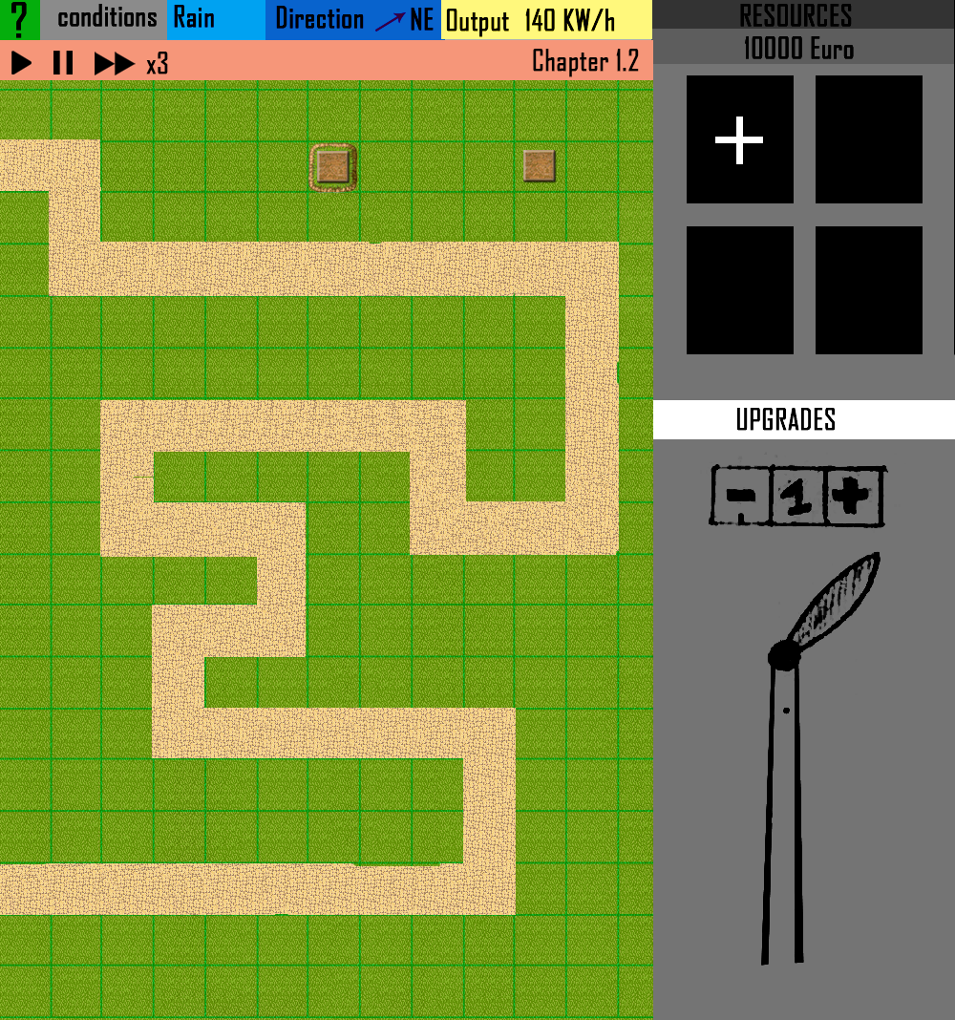
Tower defense game

Slide 8
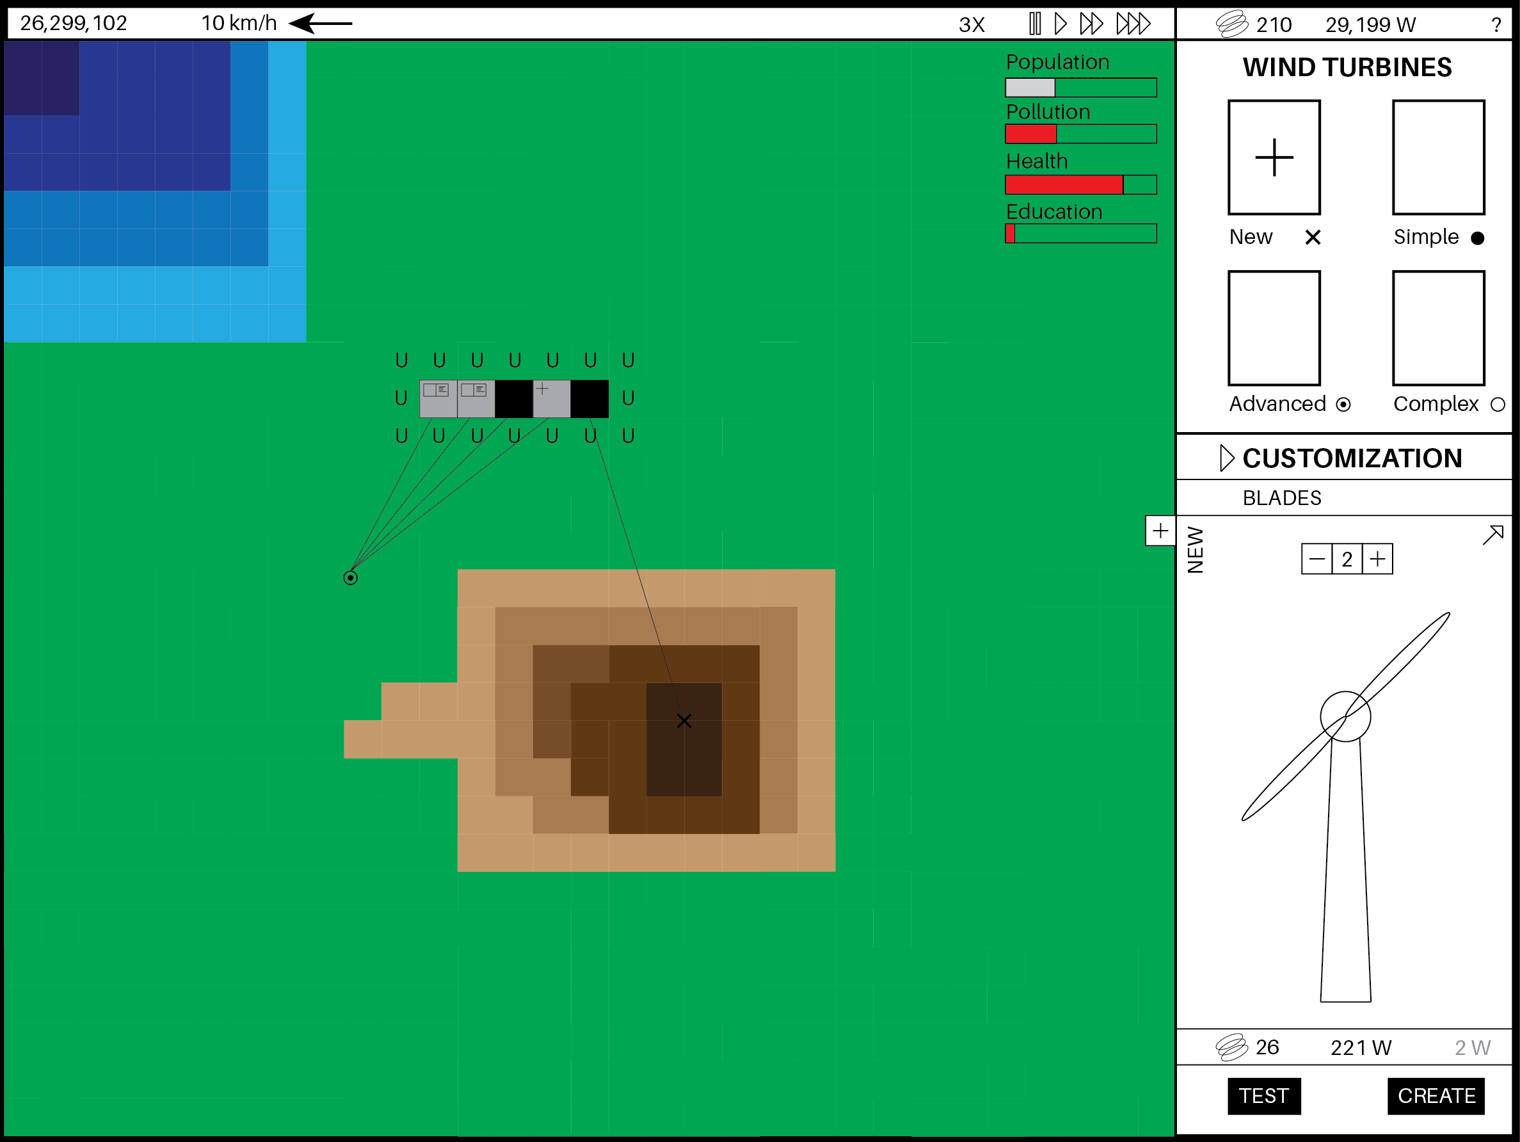
Simulation game

Slide 9
Game concept commonalities
Top bar provides crucial information: score, weather conditions, wind speed, wind direction, game speed, pollution level, total power output, current chapter, help button.
Side bar split in two.
Top side bar allows the construction of pre-set or saved wind turbines onto the game
Bottom side bar allows for customization of a new or existing wind turbine. It can also serve as a selection menu for information on the tiles.
Events (weather, or else) are incorporated in both games.
History based tutorial at the beginning of both games.

Slide 10
Tower defense concept
Kill enemies as they progress through the maze so that they not reach the other side.
Inactive turrets are pre-placed on the map. They need power from wind turbines to function.
Wind turbines can be placed on the map almost anywhere as long as foundations are there.
Pollution aspect: enemies that reach the end of the maze are killed by coal powered turrets. This increases the pollution level and has negative impact on the score.

Slide 11
Simulation concept
Build a city of X number of inhabitants every chapter.
City is powered by the wind turbines or if power is lacking external coal power plant (pollution score).
City is a single tile at the beginning and can be expanded by the player at the time of his choosing from that tile.
City tiles can be population based, population-school based (education score), population-hospital based (health score).
The scores are used to keep the city up to standard and to create inter-player scores.
Modes could be introduced. A challenge mode could ask a player to get to 1000 inhabitants with certain game mechanics as fast as possible. Another could ask ask a player to power a city with only one wind turbine, therefore requiring the most efficient turbine possible. Other modes could be thought of.

Slide 12
Wind Energy learning curve
The game chapter would introduce key concepts based on the learning objectives.
The wind mechanic introduces the player to placement and rotation of the wind turbine and/or rotor control. Control of the wind turbine could be performed live within the game.
Tiles have different values (height, soil, price of construction) to teach about wind turbine placement. Tiles can be both on land and offshore with physical differences related to the performance of the wind turbines.
The customization tab introduces concepts like number of blades, height of the wind turbine, size of the turbine, choice of power train, etc …
Economics would be introduced through modular price depending on location of construction, type of turbine, specification of turbine, maximum output of turbine.
Ability for the players to access information related specifically to the part they do not understand within the game in the MOOC. These information would be 1-2 minute videos maximum with theoretical explanations and/or text associated with it for more information.
Additional elements like learning the velocity triangle, Betz limit, load control and else would also be introduced within the game as simple game mechanics but physics based. The how is still in discussion

Slide 13
Scoring
Scoring based on the scores in both games
Leaderboard for competitive scoring between the different players

Slide 14
If we have time and money
2.5D perspective
Shadows
Better animation and graphics
3D customisation frame
Dynamic icons
Updated dynamic wind turbines
Better tiles
Narrator with a complete storyline
All chapter related to the course
Better audio and audio effects
Allow to zoom in the tiles for more details and large amount of wind turbines
Make a whole world where you could introduce other methods of producing energy (water management). Some sort of Sim City for resource management.
Make direct feedback conditional to the design of the custom built wind turbines.

Slide 15
?

